Slide 1


Housing Price Prediction
By Avinash Patel

Slide 2


INDEX
Importing Dataset
Cleaning The Dataset
Visualization
Skewness and Outlier Removal
Model Selection
Hyperparameter Tuning
Saving The Model
Making the data ready for the model

Slide 3
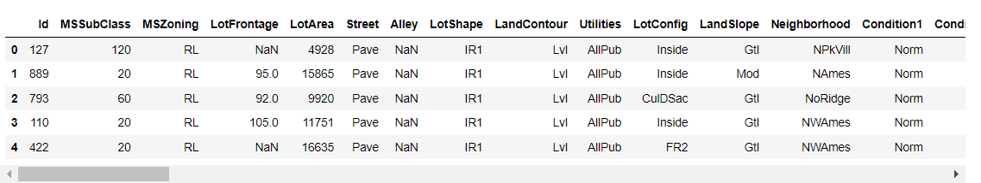
Importing Dataset
First step is to import the csv file into the Jupiter notebook.

Slide 4
After importing we check any of the columns have null values or not and also see
some basic information's about all the columns.
Like number of unique variables in each columns.

Slide 5
Cleaning The Dataset
After some information about the dataset we are going to clean the columns individually.
Categorical Column: There are 35 categorical column many of them are columns with high amount of null and zero values in them and we are going to delete these column as it is of no use for us. The other column are numerical columns so we are going to separately evaluate them.
Numerical Column:
For MSSubClass:As per our data description this column coluld have only 20,30,40,45,50,60,70,75,80,90,120,150,160,180,190.So any thing other than these values is a outlies or bad datapoint but here there are no such datapoints that means all the values are good.

Slide 6
Treating For LotFrontage: Many of the rows have null value so we are going to give those rows the mean of all the rows.
Treating last_rech_date_da column: By looking at the xml file this column has mostly 0 as values. Hence I am checking how many 0 there are.
Treating OverallQual column: As per our data description this column coluld have only 1,2,3,4,5,6,7,8,9,10 . So any thing other than these values is a outlies or bad datapoint but here there are no such datapoints that means all the values are good.
Treating LotFrontagecolumn :Many of the rows have null value so we are going to give those rows the mean of all the rows.
Treating MasVnrArea column:Checking how many rows are 0,Hence I am checking how many 0 there are and 75% of data are zeros. So, I am going to delete this column.

Slide 7
Treating BsmtFinSF2 columns:Checking how many columns are 0 Hence I am checking how many 0 there are and 95% of data are zeros. So, I am going to delete this column.
Treating 2ndFlrSF column:Checking how many rows are 0,Hence I am checking how many 0 there are and 75% of data are zeros. So, I am going to delete this column.
Treating LowQualFinSF column:Checking how many rows are 0,Hence I am checking how many 0 there are and 90% of data are zeros. So, I am going to delete this column.
Treating BsmtFullBath,BsmtHalfBath,FullBath,HalfBath column:Among all these three columns BsmtFullBath,BsmtHalfBath and the HalfBath are the only columns does have zeros in there rows which are more than 70%. So we are going the keep the FullBAth column only and delete the rest of the columns as we already do not have much data to begin with and on top of that all the rows are already empty. This could effect our model.
Treating WoodDeckSF, OpenPorchSFcolumn: These columns also do not have much data as most of the data is empty to begin with.

Slide 8
Treating nclosedPorch,3SsnPorch,ScreenPorch,PoolArea,MiscVal: More than 75% of the data is null so we have to delete these columns as well.

Slide 9
Catagorical Column:
Treating MSZoning: In this column one of the values is C(All) so we are going to replace all these values to C for better understanding.
Treating Utilities: This column has only one type of value which is AllPub ,hence only one value is not sufficient for building a model as no variety is there to give predictions upon.
Treating Condition2, RoofMatl, Heating:All these columns have lots of null value in them so we are going to delete all of these columns.Now after encoding our data we are going to find the correlation between our target variable and the categorical variables.After doing that we discovered that columns 'ExterQual', 'BsmtQual', 'KitchenQual', 'SalePrice' have more than 50% of correlation with our target variable and columns 'Neighborhood', 'RoofStyle','Foundation','BsmtExposure','HeatingQC','GarageType','GarageFinish' have corelation between 20% to 50% and columns 'MSZoning', 'Street', 'LotShape', 'LandContour', 'LotConfig', 'LandSlope', 'Condition1', 'BldgType', 'HouseStyle', 'Exterior1st', 'Exterior2nd', 'MasVnrType', 'ExterCond', 'BsmtCond', 'BsmtFinType1', 'BsmtFinType2', 'CentralAir', 'Electrical', 'Functional', 'FireplaceQu', 'GarageQual', 'GarageCond', 'PavedDrive', 'SaleType', 'SaleCondition' have correlation lower than 20%.

Slide 10
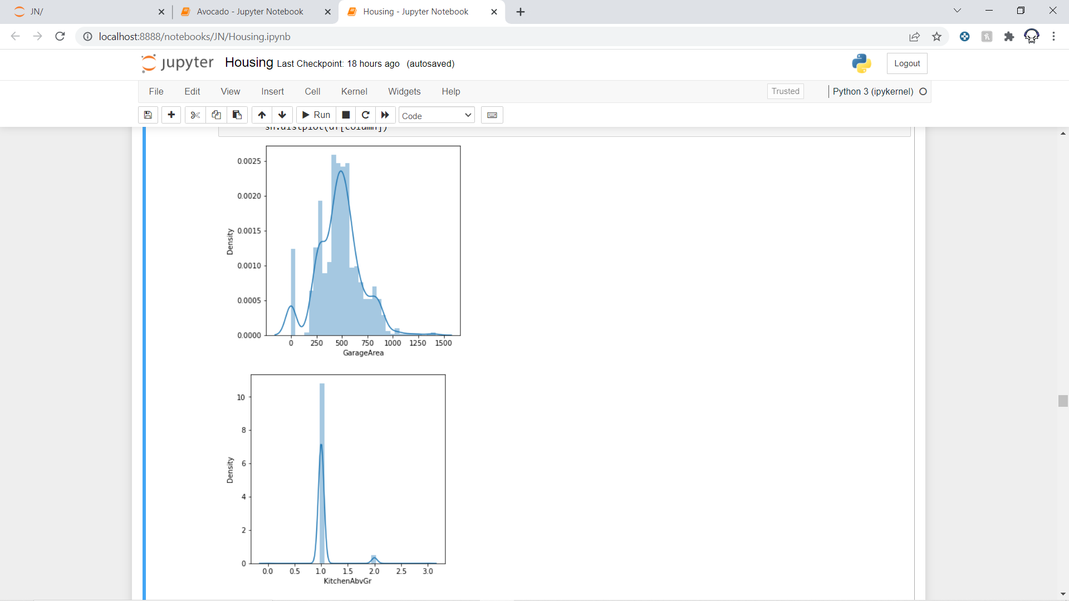
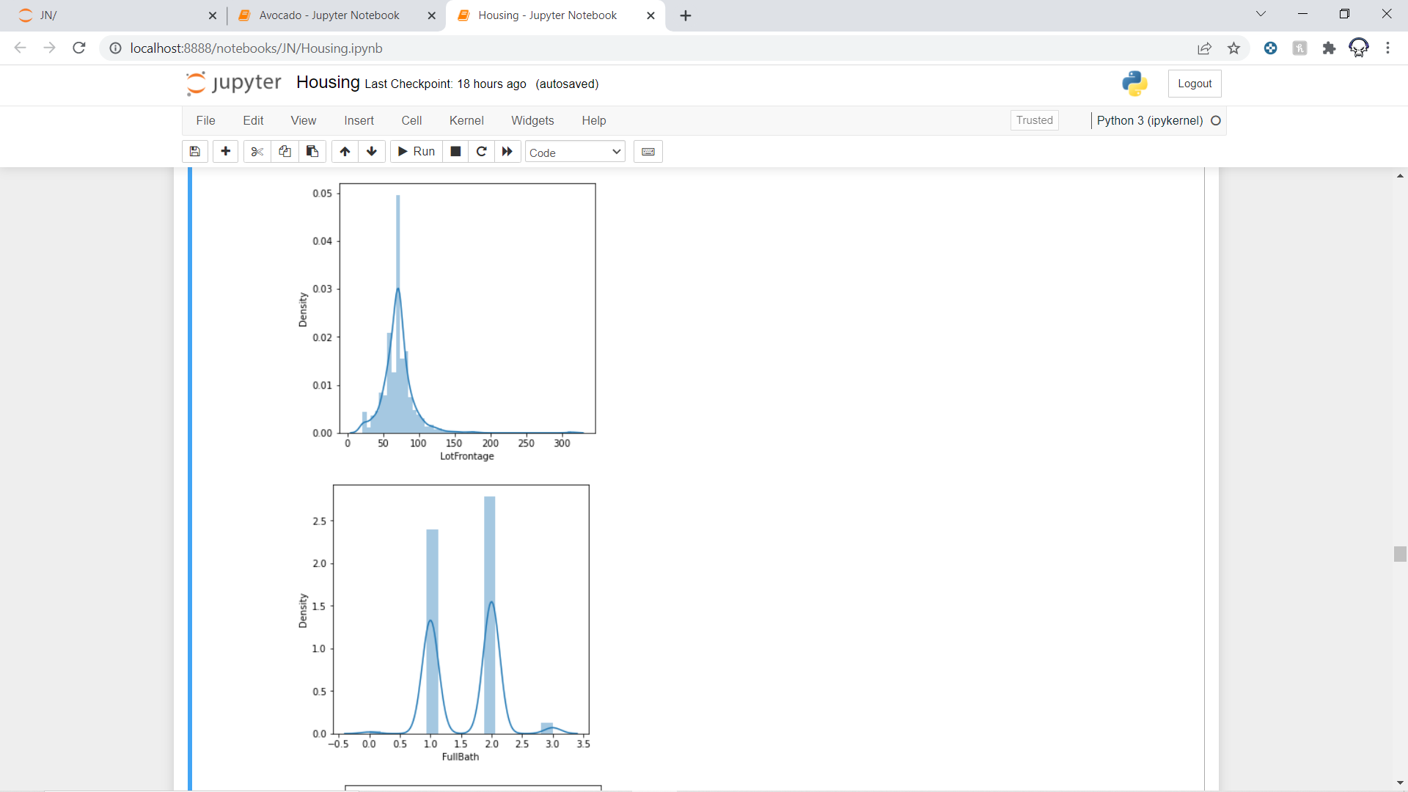
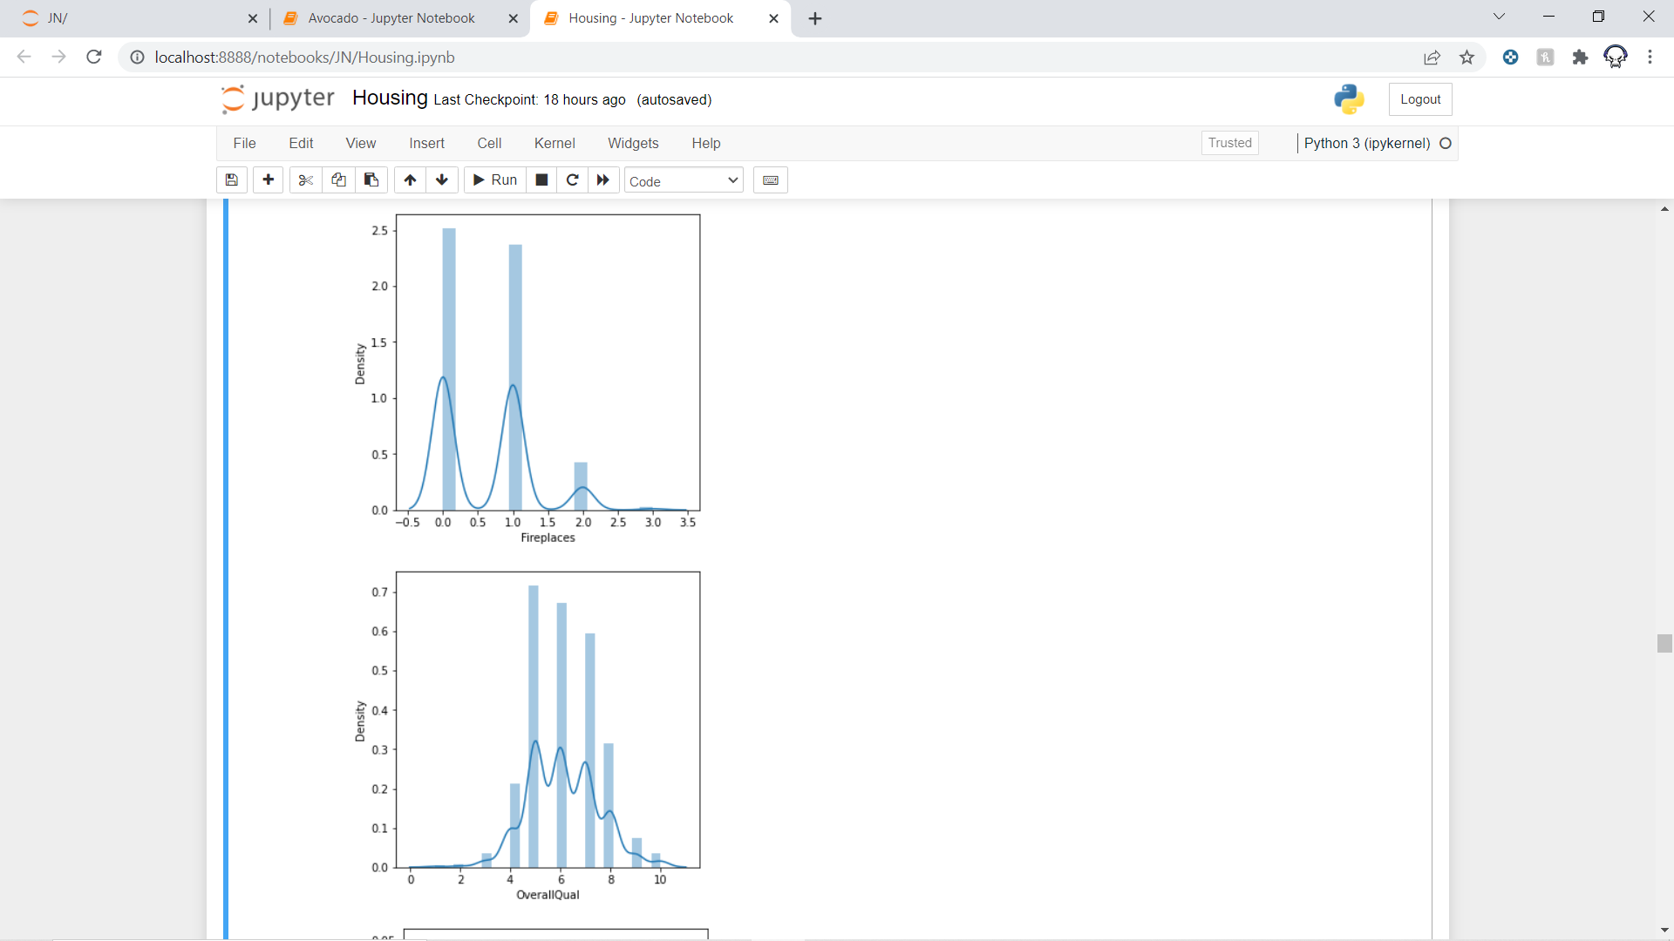
Visualization
Distplot:

Slide 11
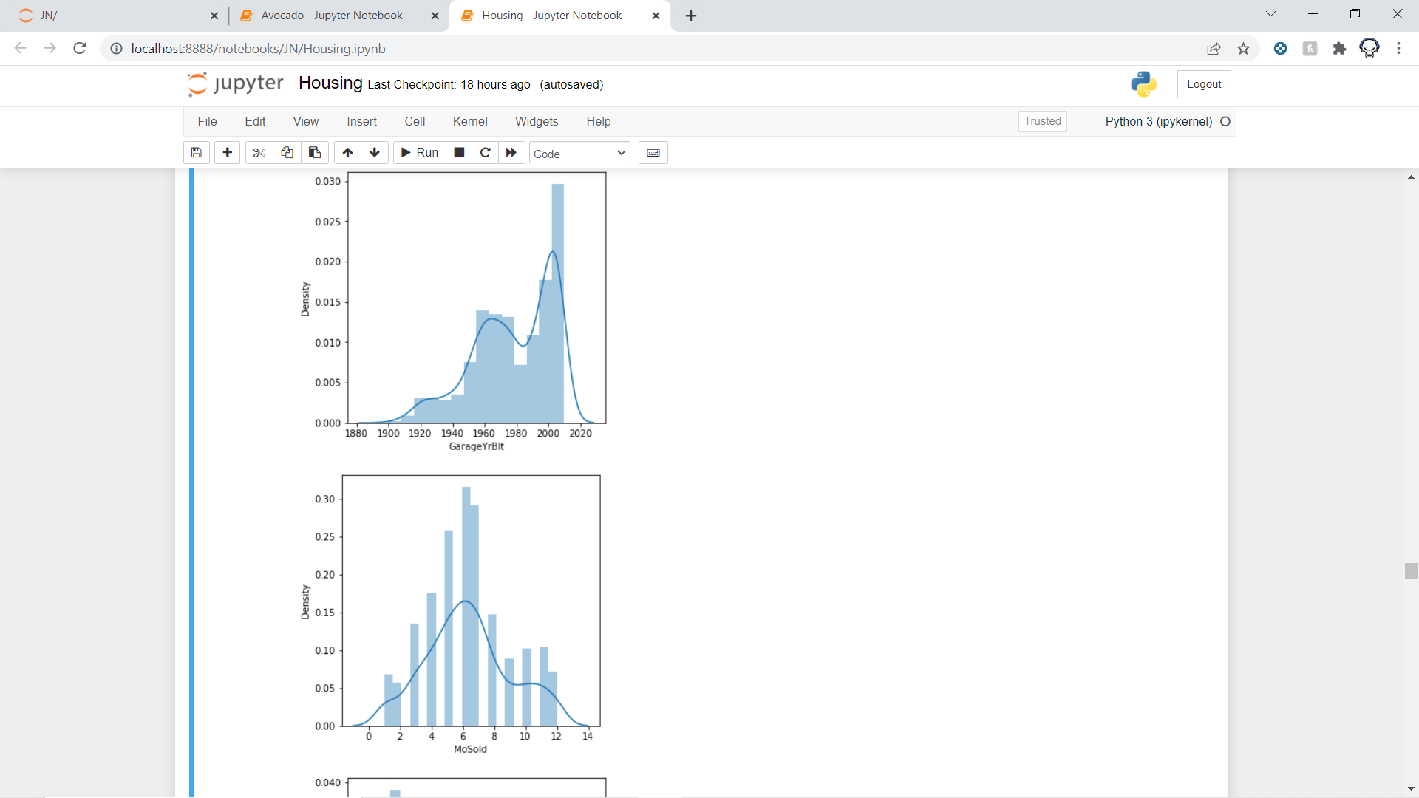
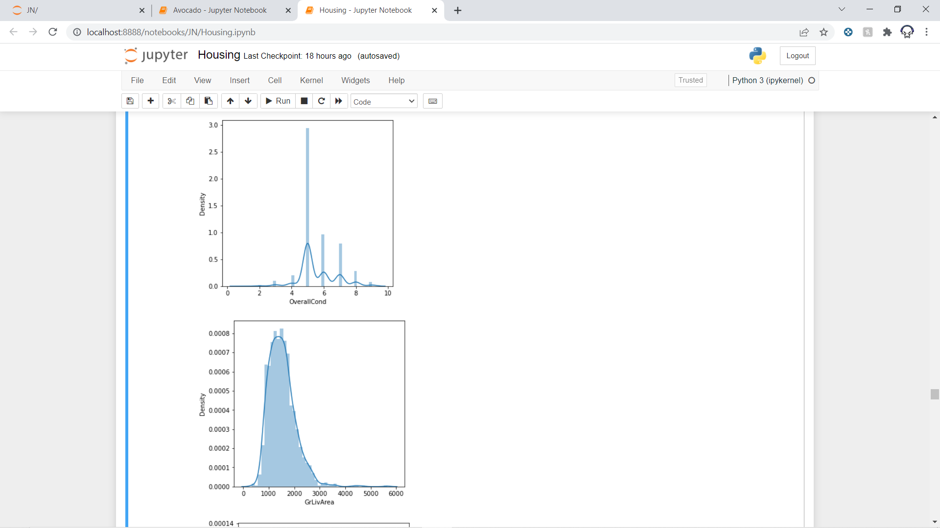
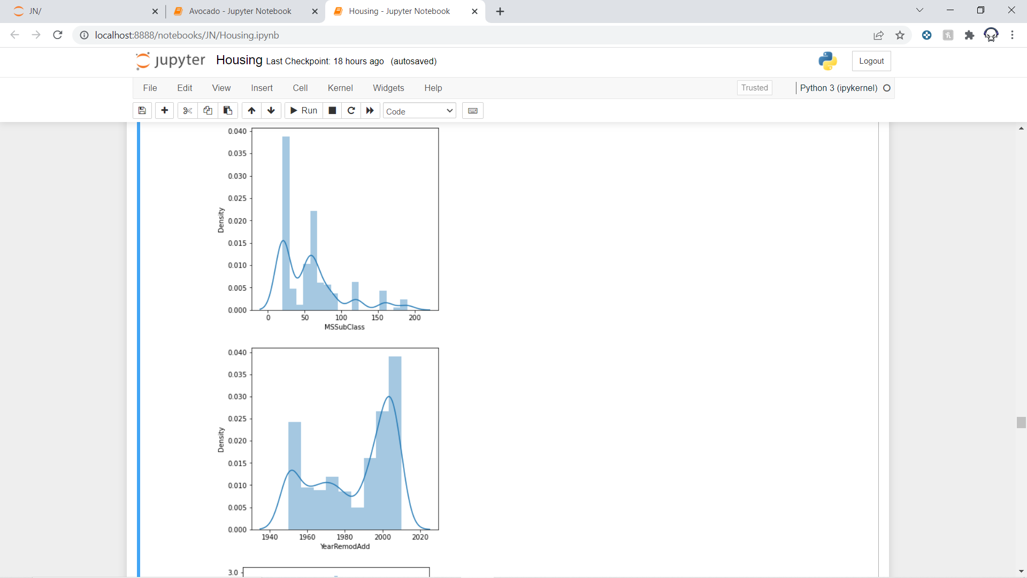

Slide 12

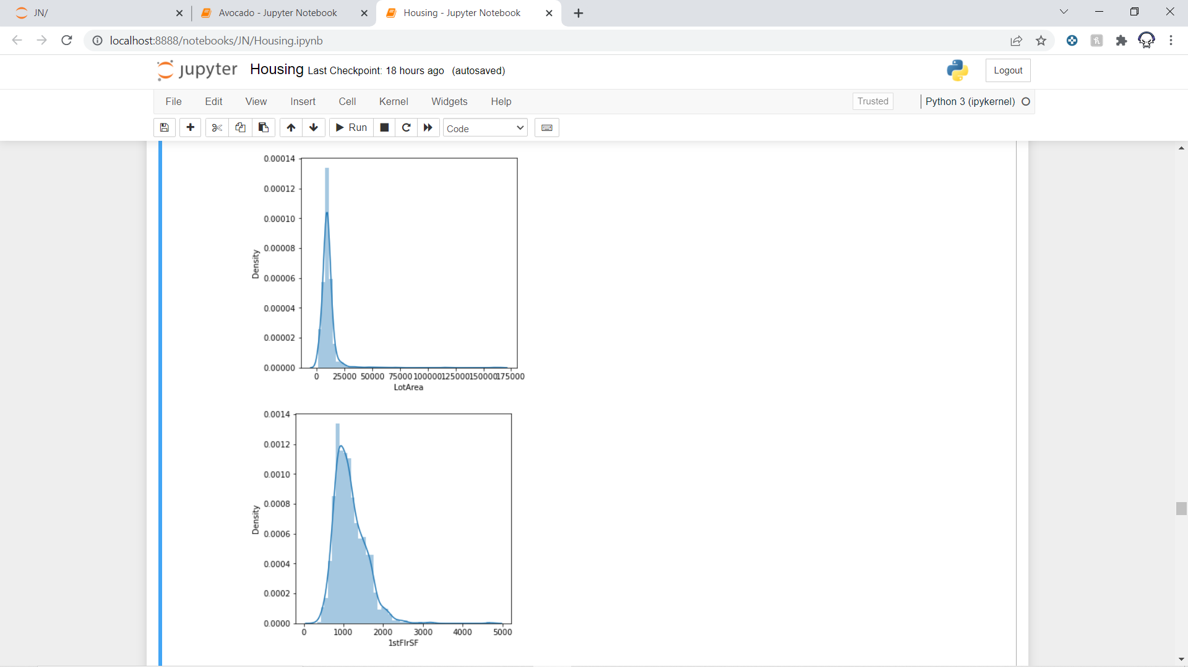
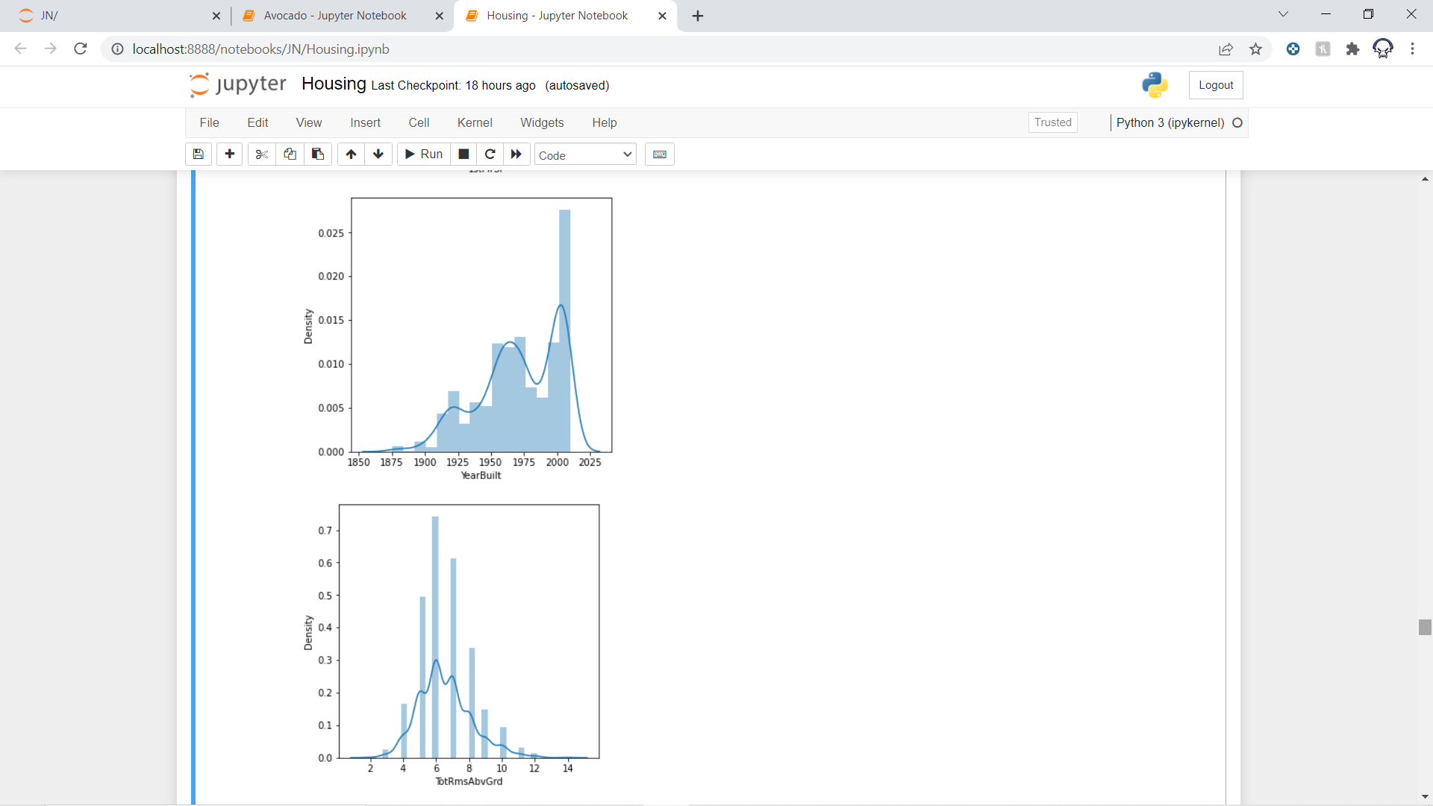

Slide 13
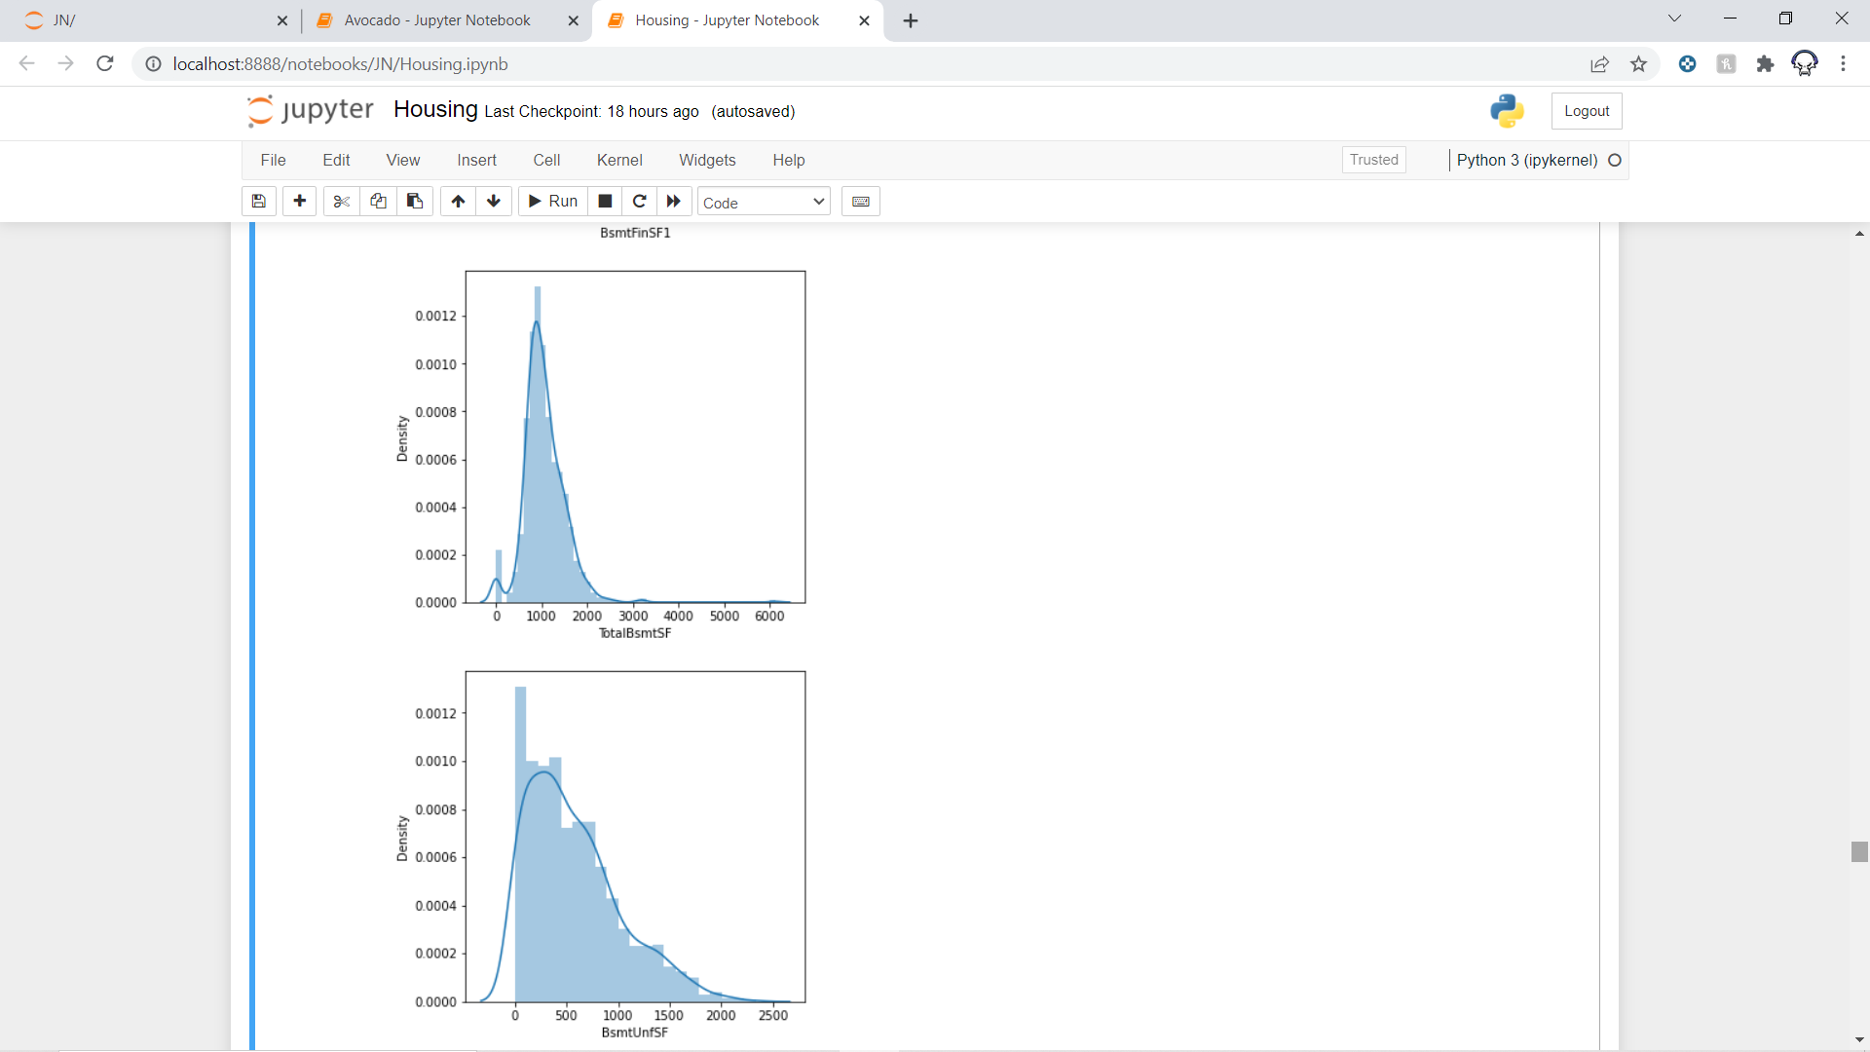
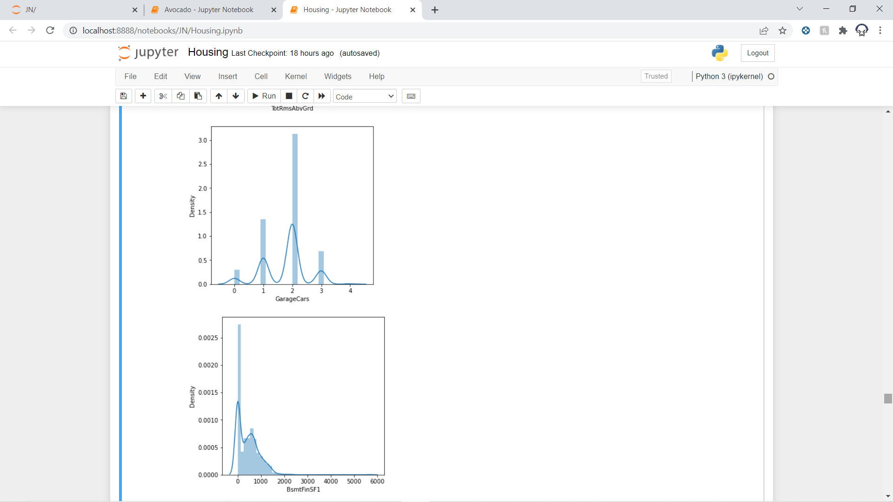
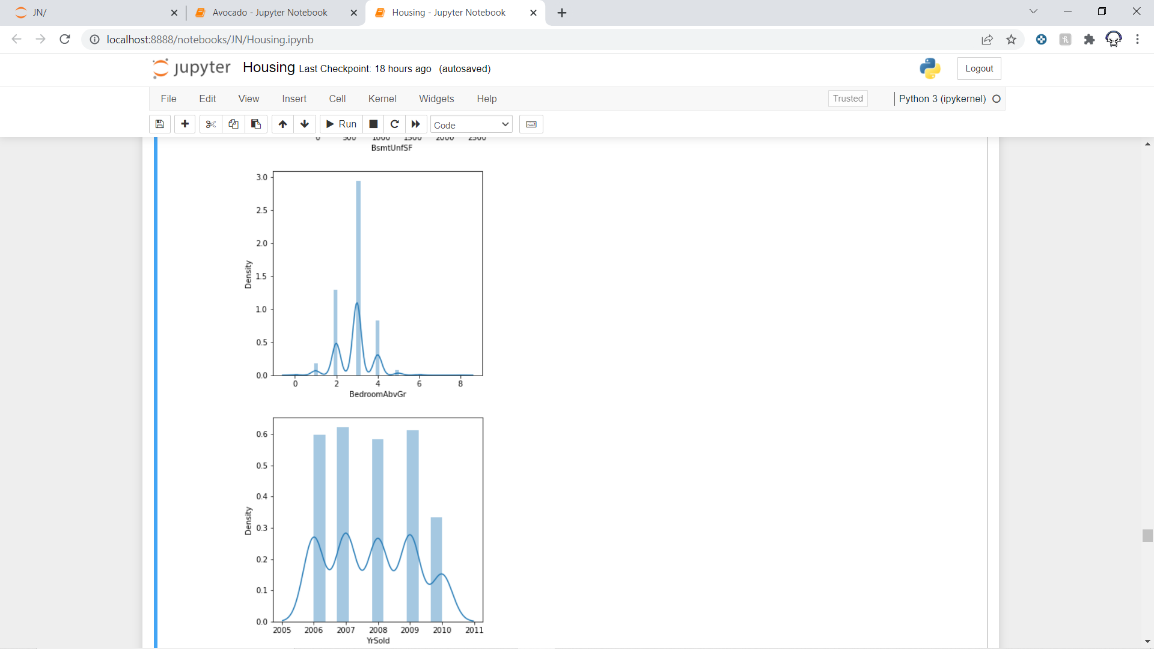

Slide 14
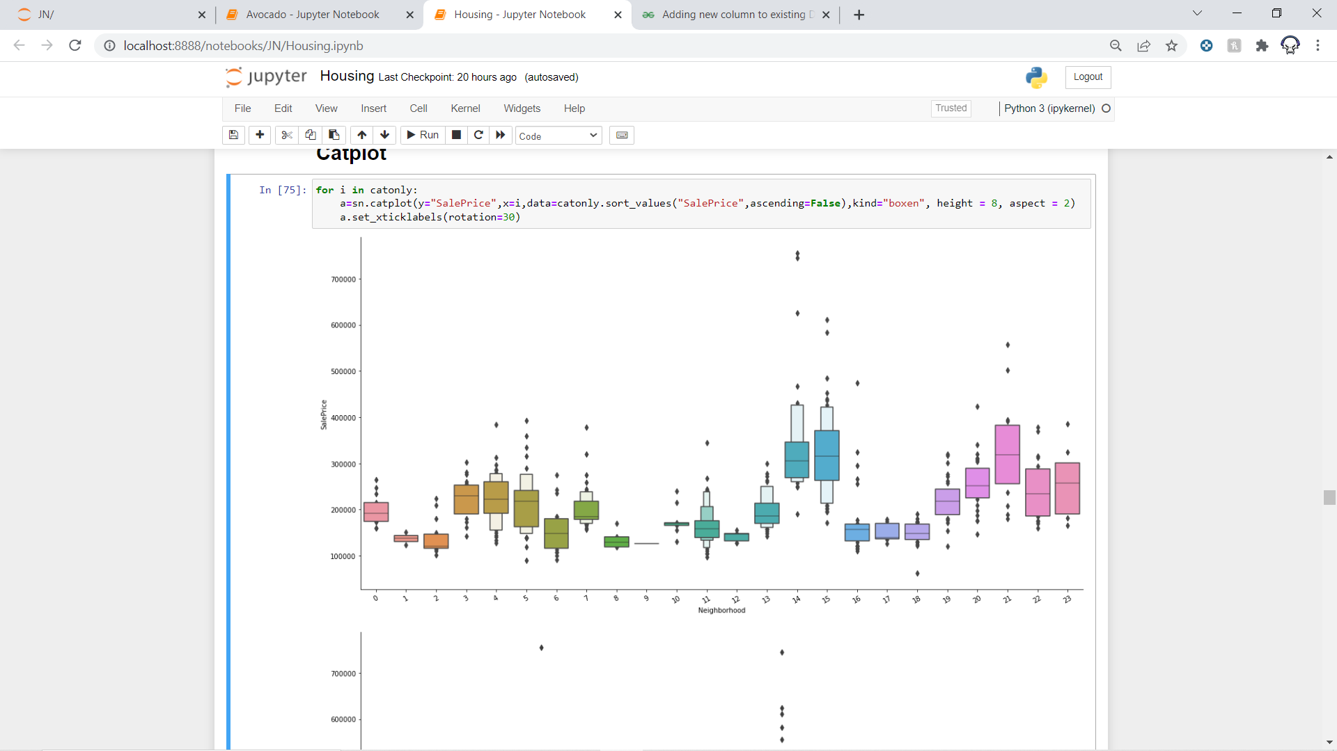
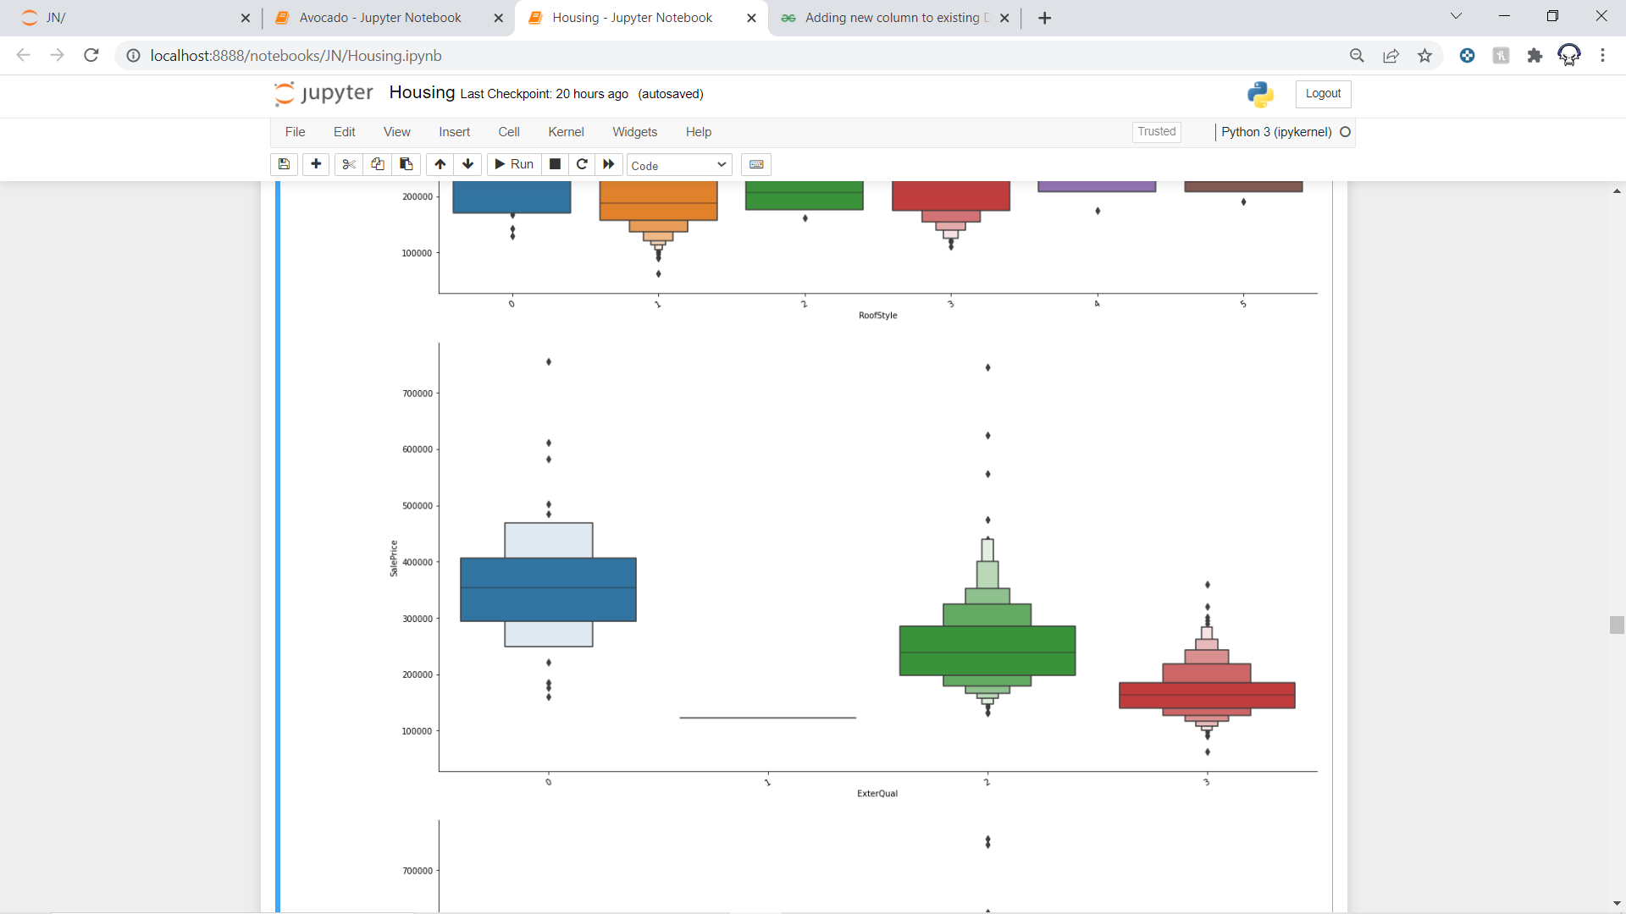
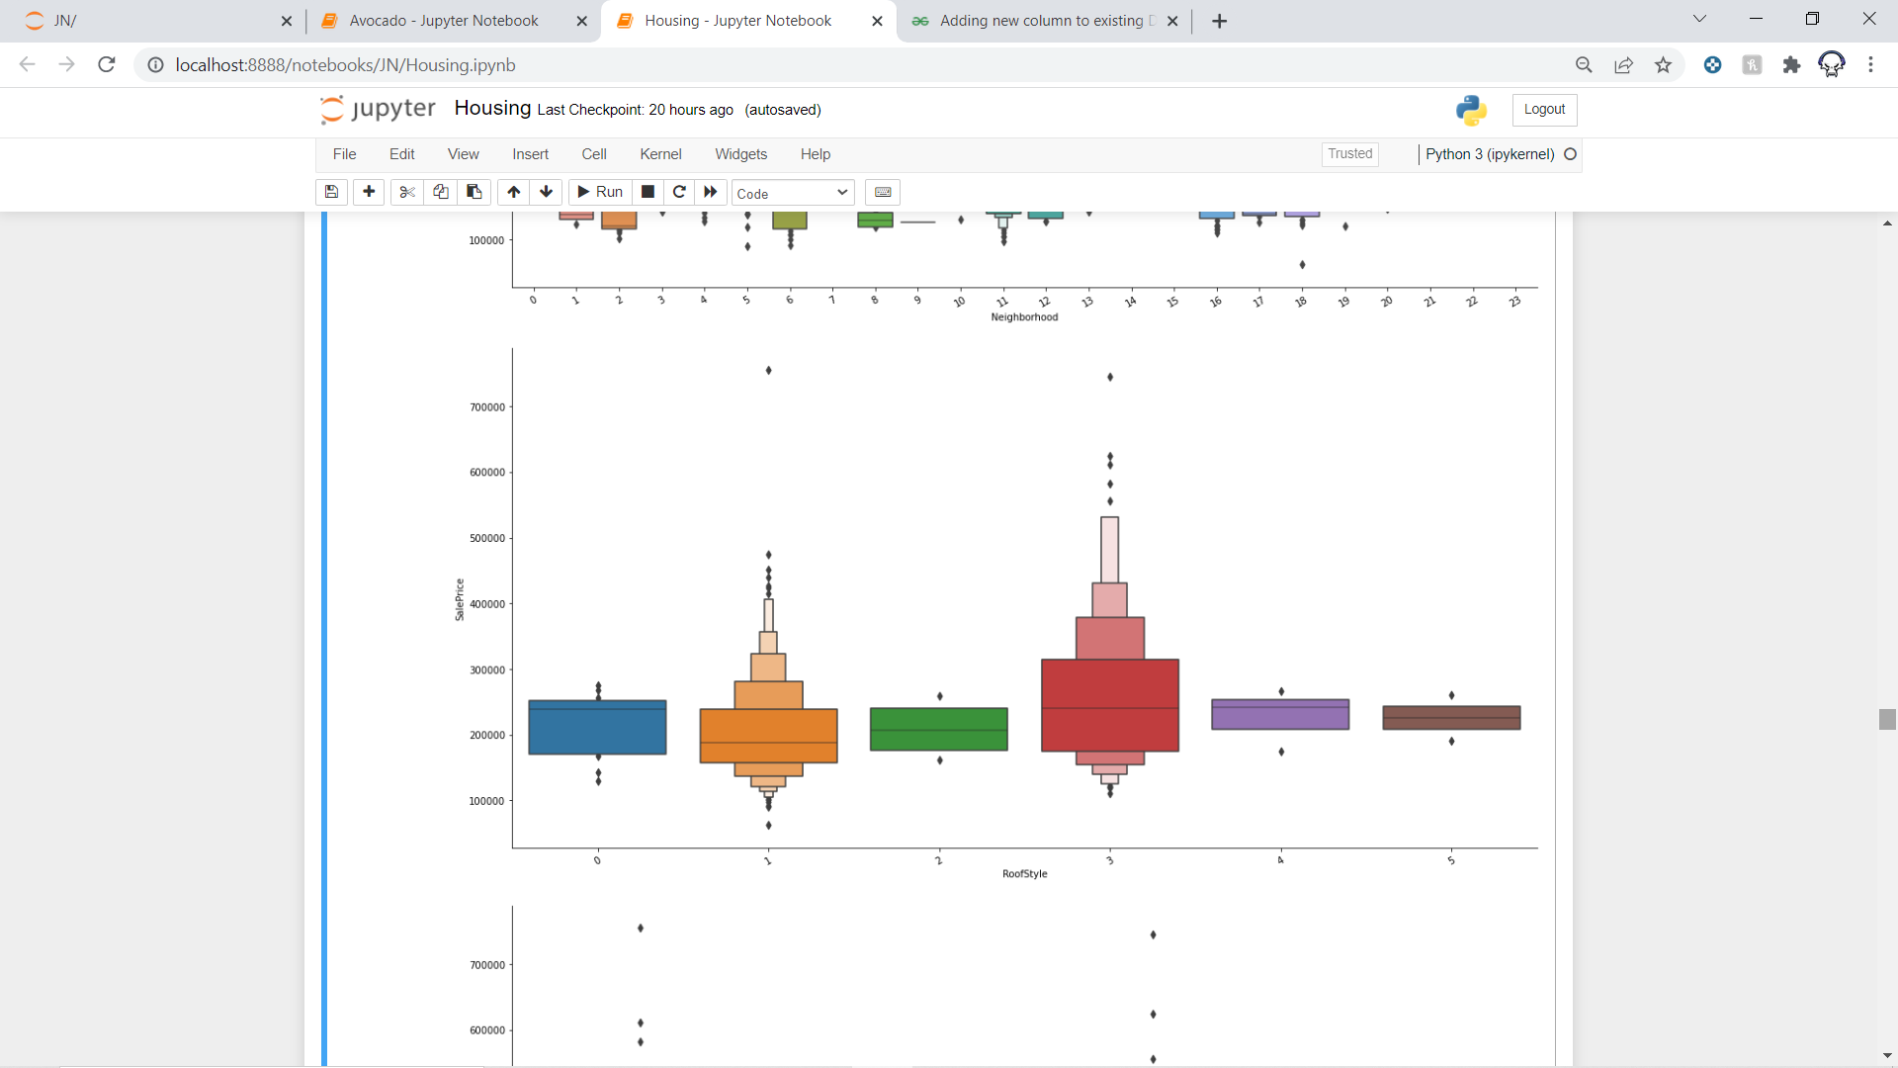
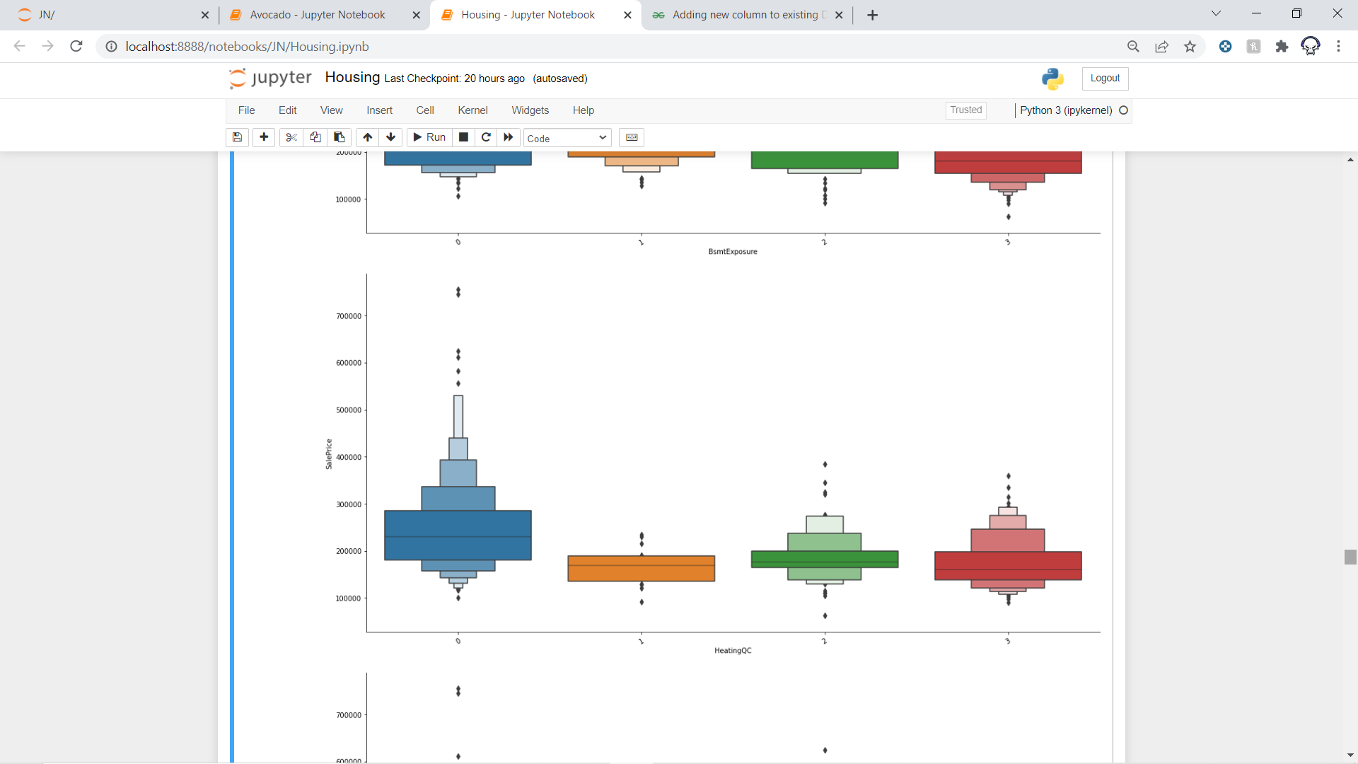
Countplot:

Slide 15
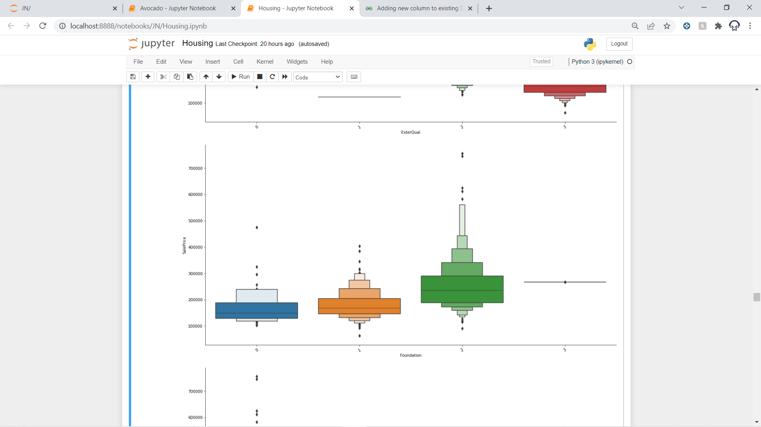
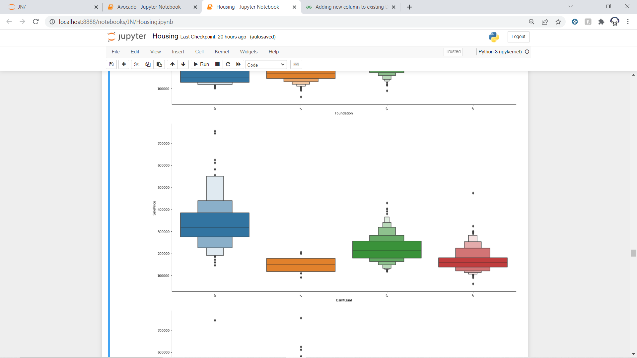
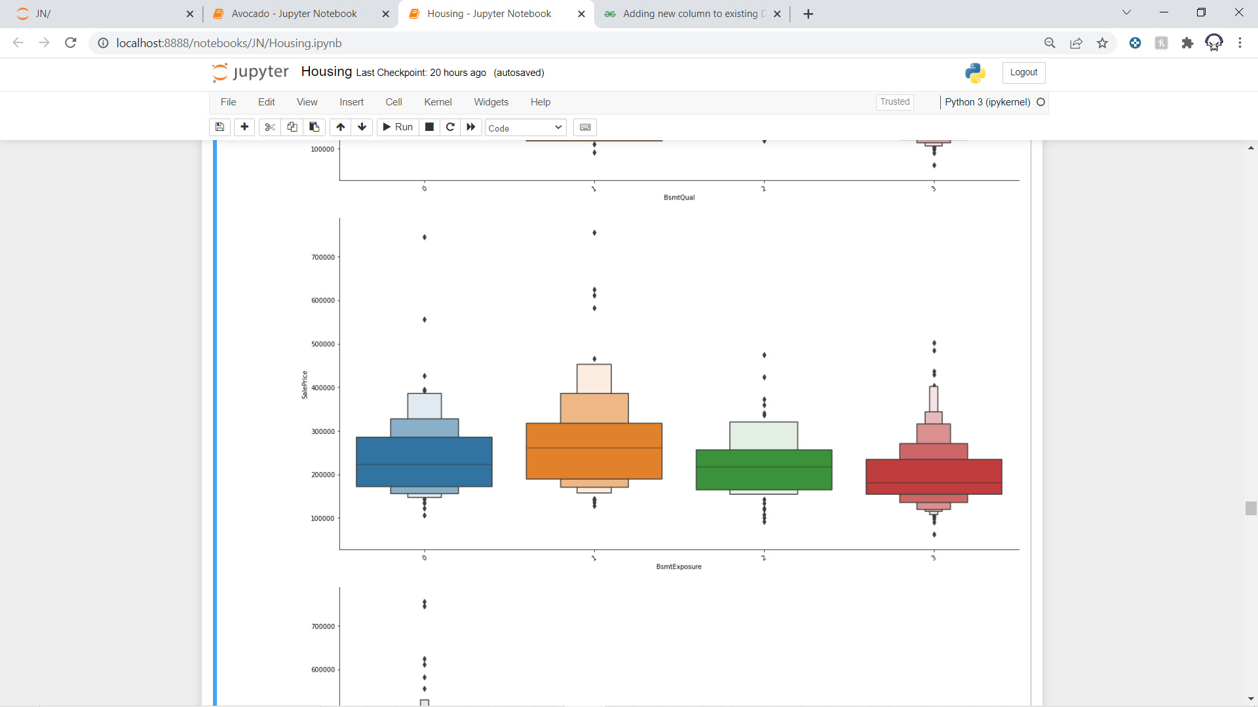
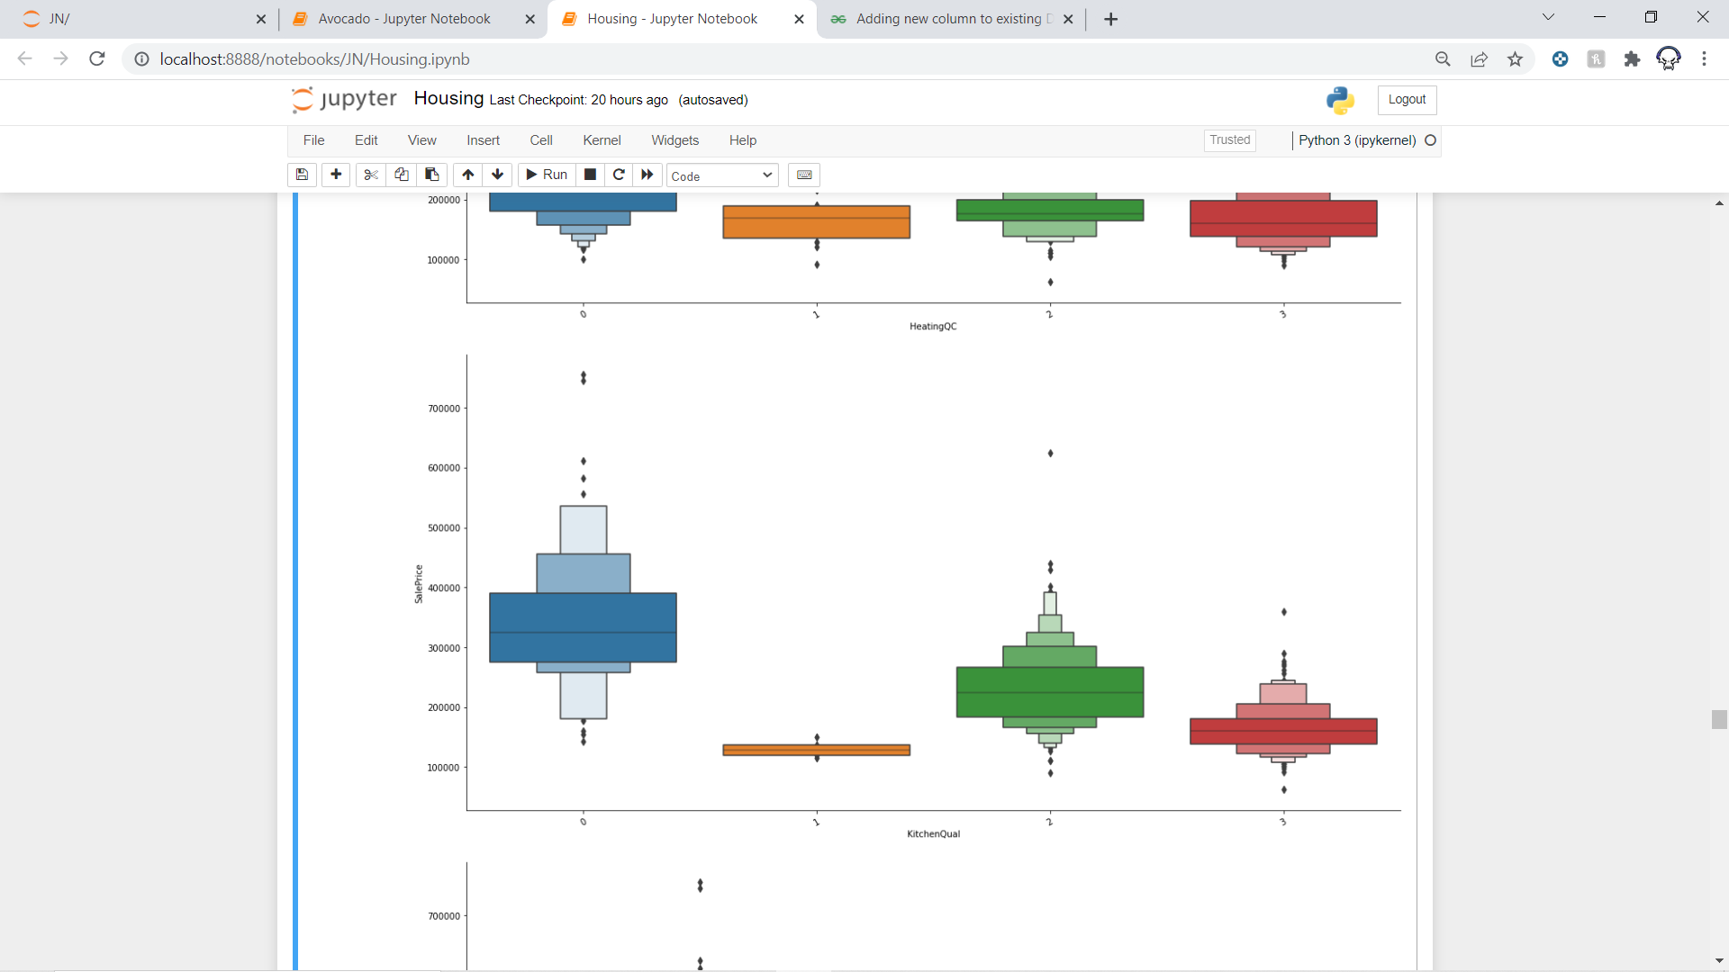

Slide 16
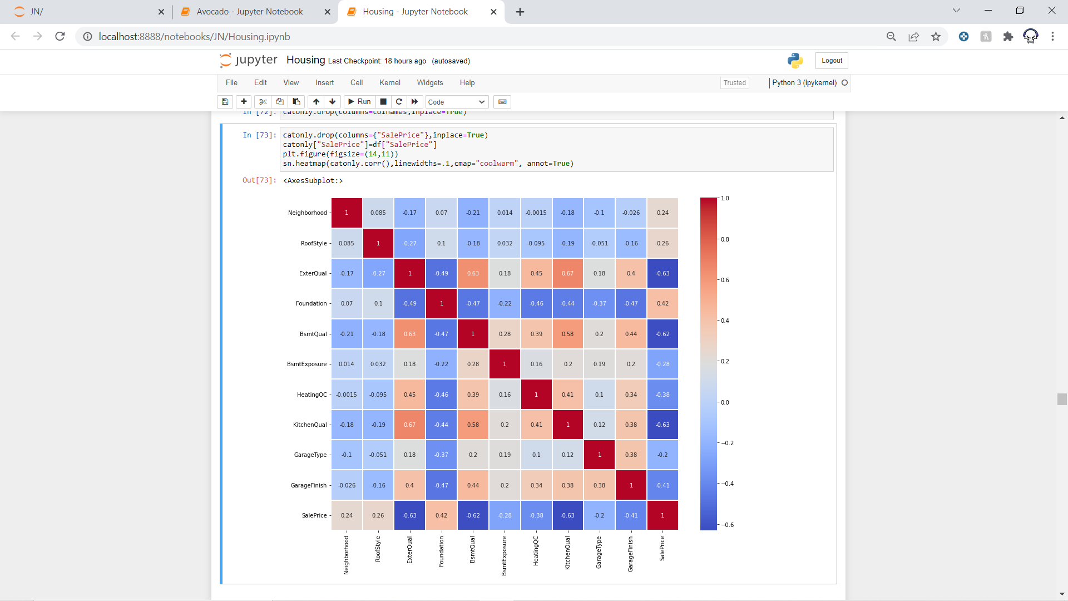
Heatmap

Slide 17
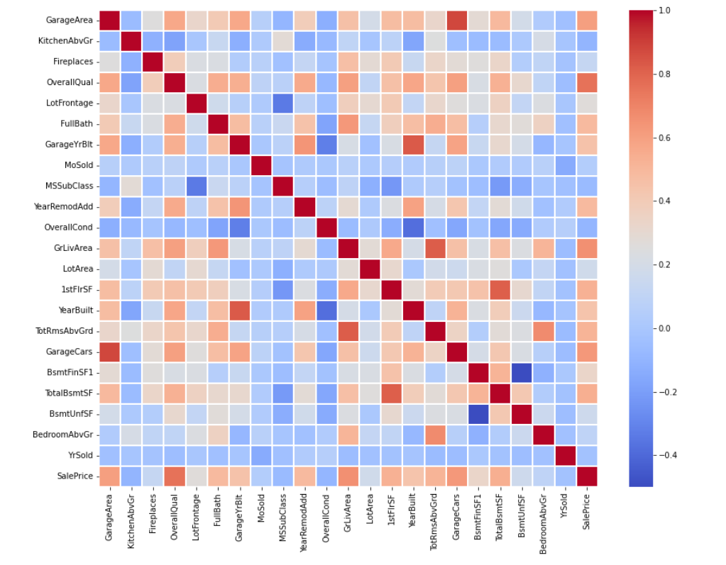

Slide 18
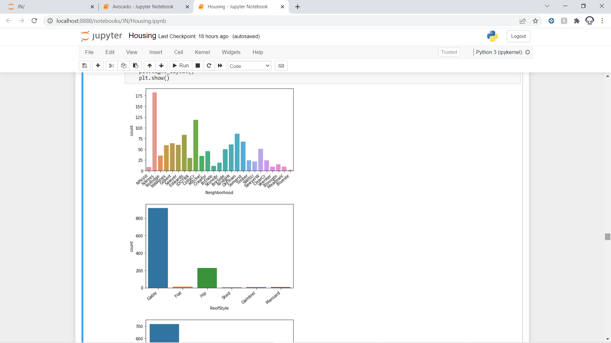
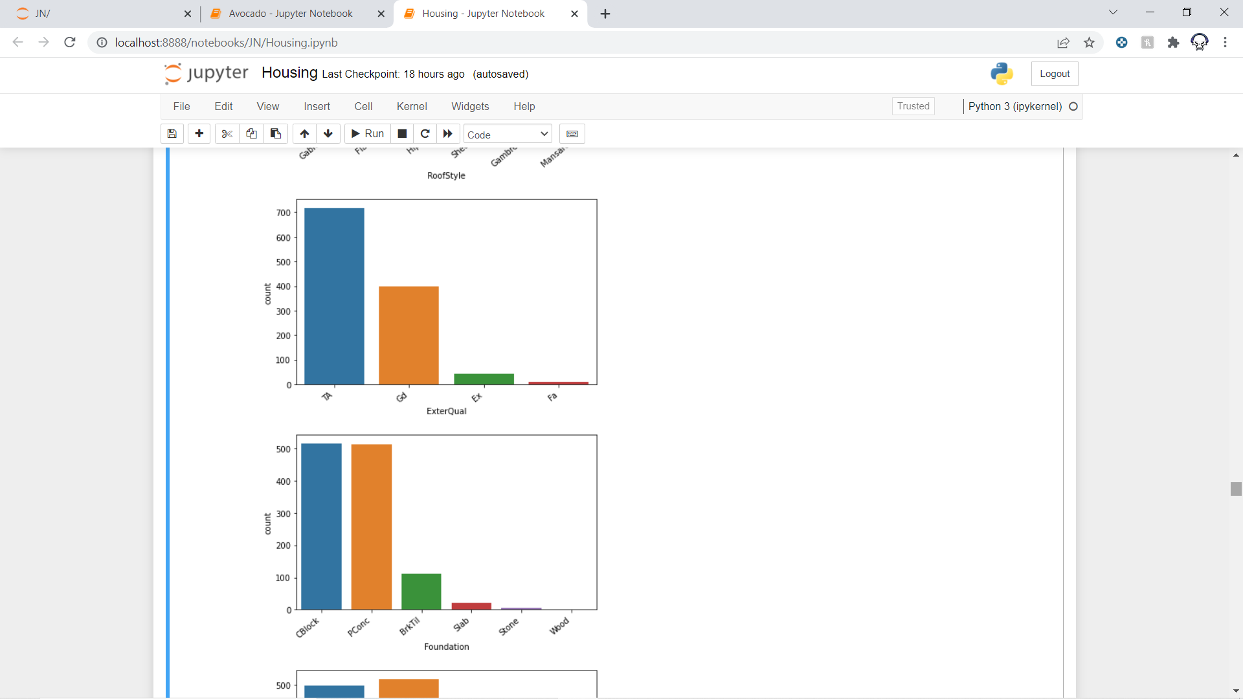
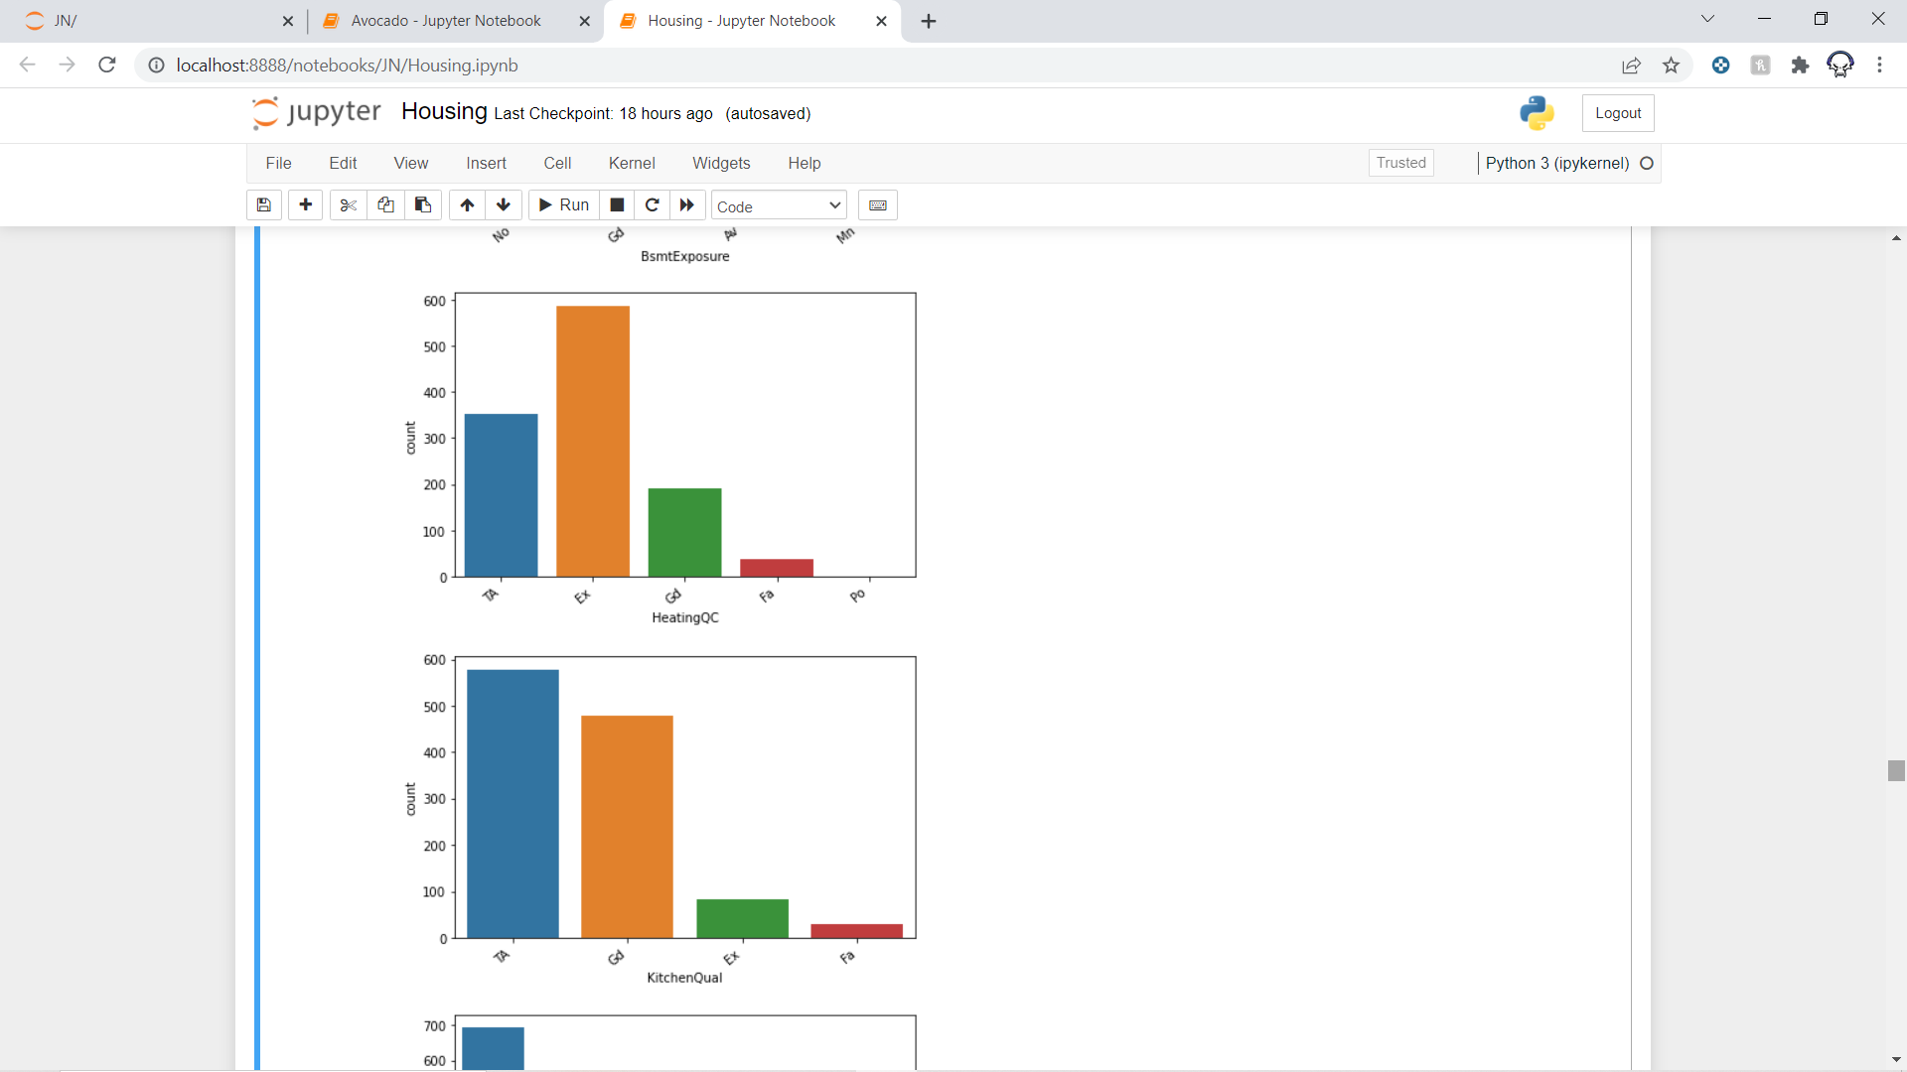
Count plot
As we can see the data is clearly highly imbalanced.

Slide 19
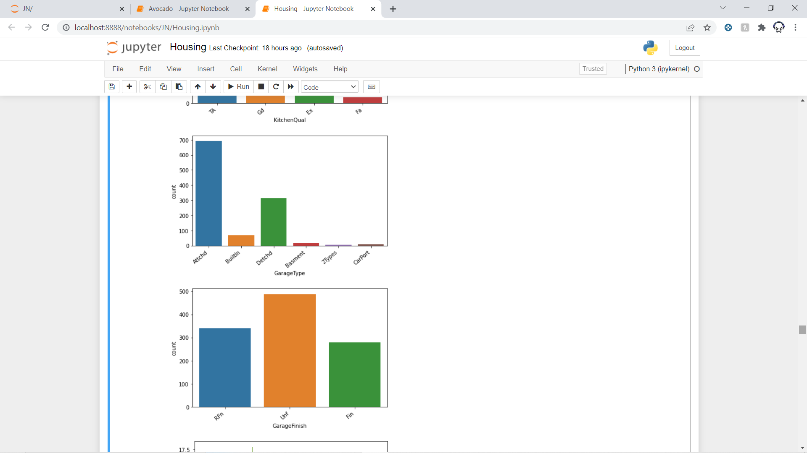
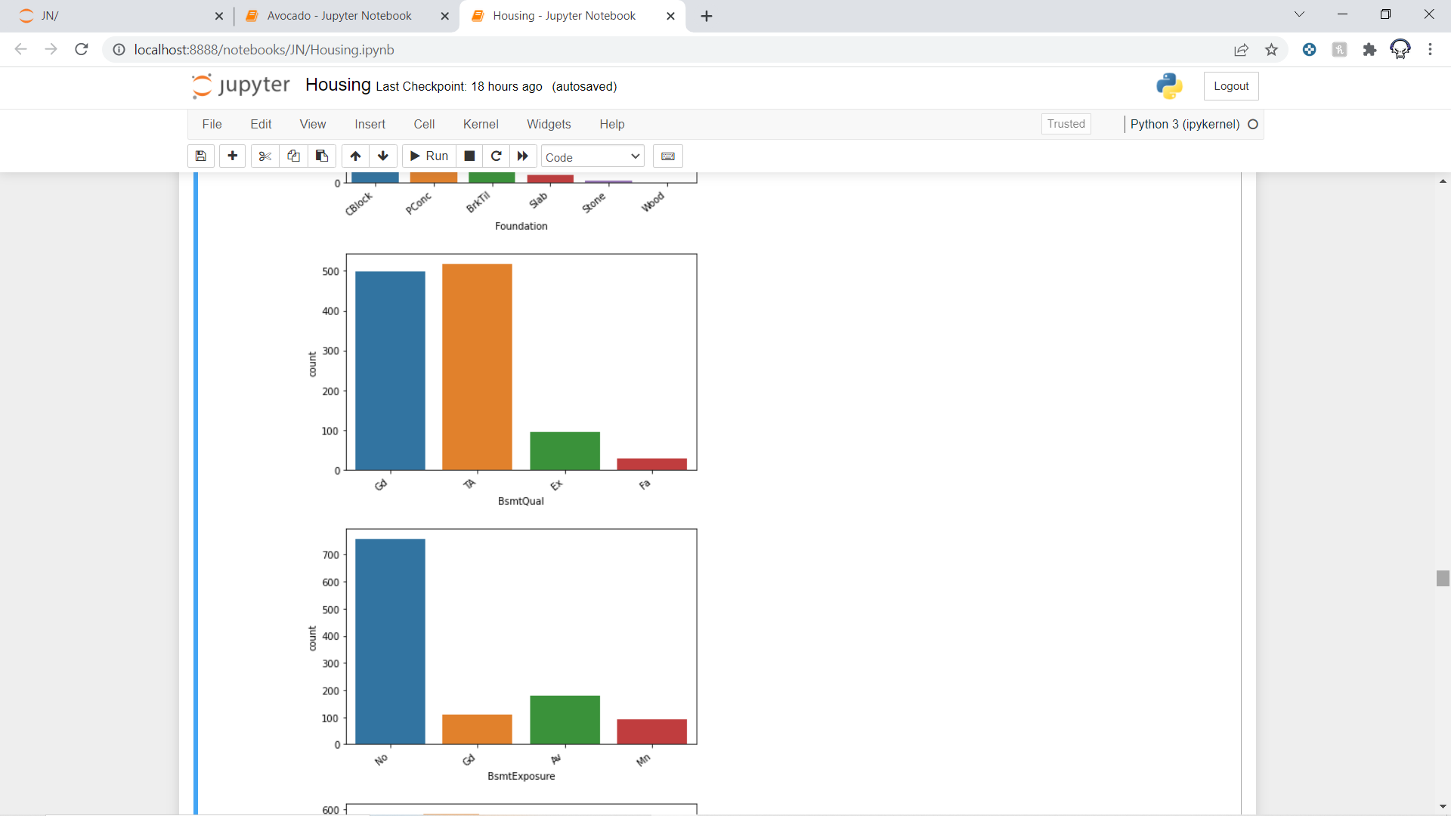

Slide 20
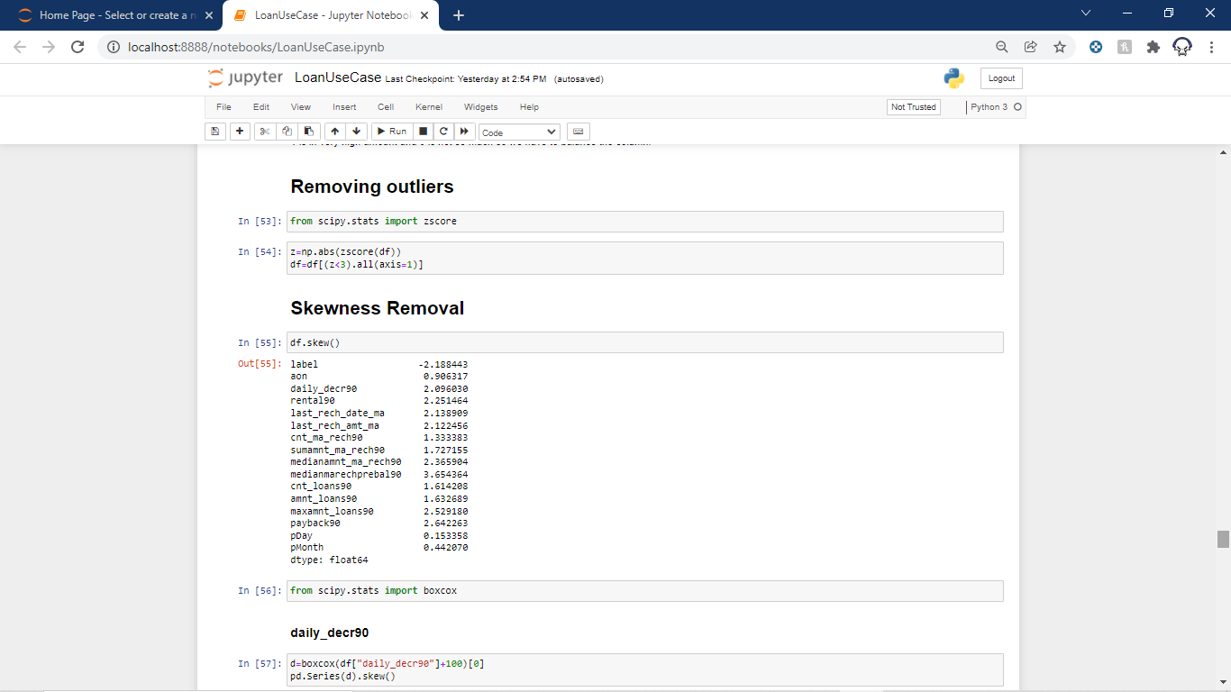
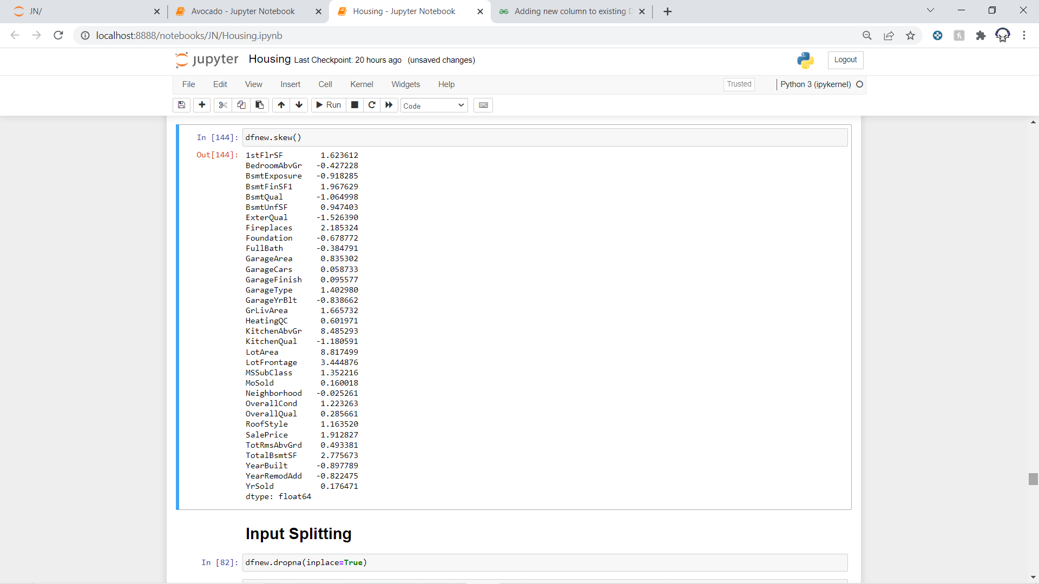
Skewness and Outlier Removal
We have removed Outliers individually and for skewness there is no need for that.

Slide 21
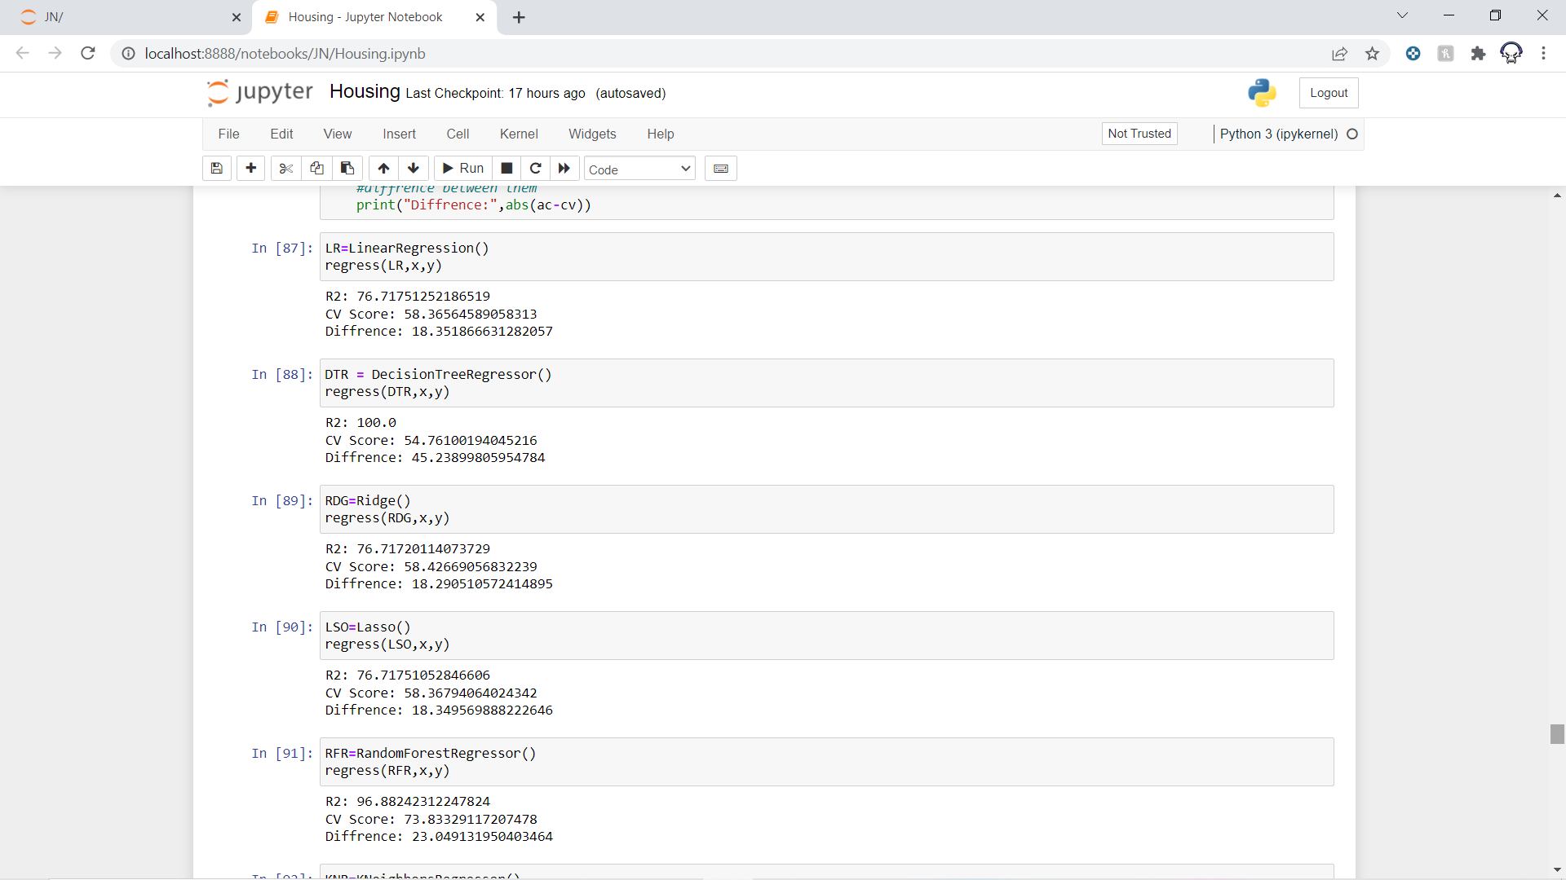
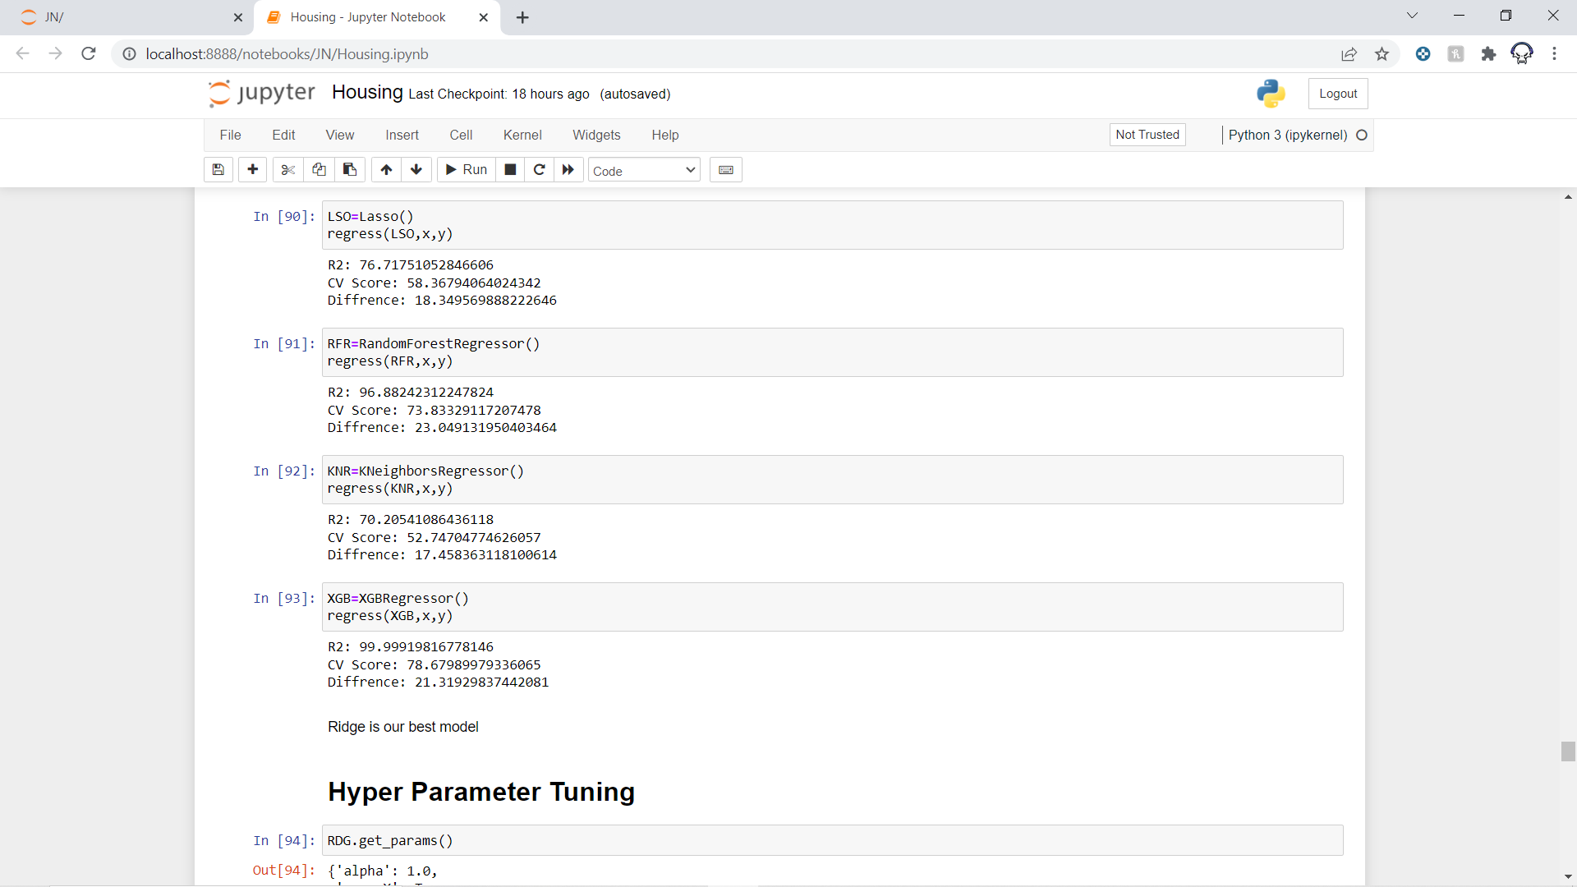
Model Selection
Now we will see some accuracy and cross validation scores of different model so that we can select the best fit model for our project.
Hence Ridge Regressor has the lowest difference between accuracy and cross validation score.

Slide 22
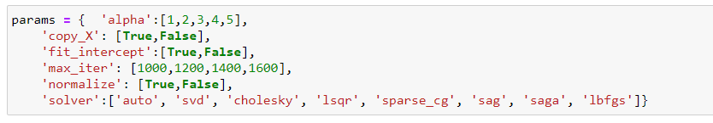
Hyperparameter Tuning
Now as we selected Ridge Regressor as our model. Now we are going to tune its parameters to make the model a little better.
Parameters are:

Slide 23
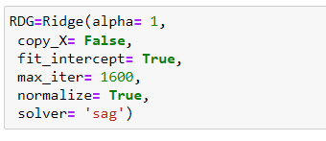
After doing the tuning we find out the following.
The Above parameters are the best parameter for this type of dataset for our model. So finally we fitted the data with these parameters.

Slide 24
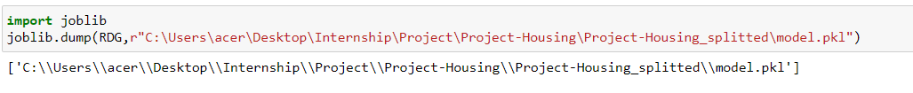
Saving The Model
The final job is to save the model which is done by Joblib library.

Slide 25
THANK YOU!!!

